Slide 1

Blazor in .net 8

Slide 2
Agenda
New Feature
BlazorWeb Hosting
Render Mode
LifeCycle
PreRender
123

Slide 3
New Features
Feature | Detail | Hosting Support
 |  | Web | WebAssembly | Server(7.0)
Form | AntiforgeryToken | ✔️ | ✔️ | ✔️
 | SupplyParameterFromFormAttribute | ✔️ | ✔️ | ✔️
 | Enhanced form handling | ✔️ | ✔️ | ✔️
DataBinding | Two way binding: @bind:get/set | ✔️ | ✔️ | ✔️
Stream Rendering | StreamRenderingAttribute | ✔️(Server) | ❌ | ❌
Error Page | Default errorpage: /Pages/Error.razor | ✔️ | ❌ | ✔️
Route to named elements | Navigation.NavigateTo("/counter#targetElement"); | ✔️ | ✔️ | ✔️
Webcil packaging | Published with .wasm instead of .dll file | ✔️(WebAssembly) | ✔️ | ❌
Handle errors | Use ComponentBase.DispatchExceptionAsync | ✔️ | ✔️ | ✔️
 | Use IHostEnvironment | ✔️ | ❌ | ✔️
WebAssembly Runtime | Configure the .NET WebAssembly runtime | ✔️(WebAssembly) | ✔️ | ❌
Dialog | Support for dialog cancel and close events | ✔️ | ✔️ | ✔️

Slide 4
New Features
Feature | Detail | Hosting Support
 |  | Web | WebAssembly | Server(7.0)
Quick Grid | Blazor QuickGrid component from .net 7 | ✔️ | ✔️ | ✔️
Render outside asp .net core | Render Razor components outside of ASP.NET Core

Slide 5
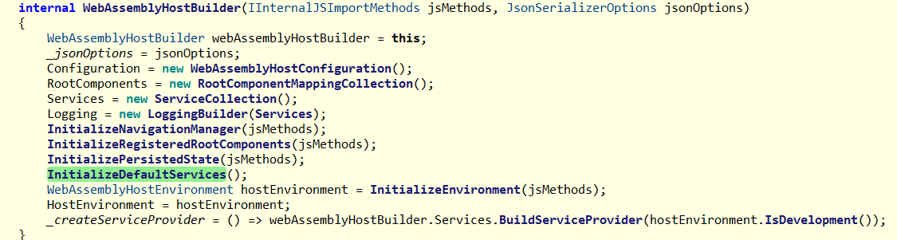
BlazorWeb Hosting
WebAssemblyHostBuilder.cs

Slide 6
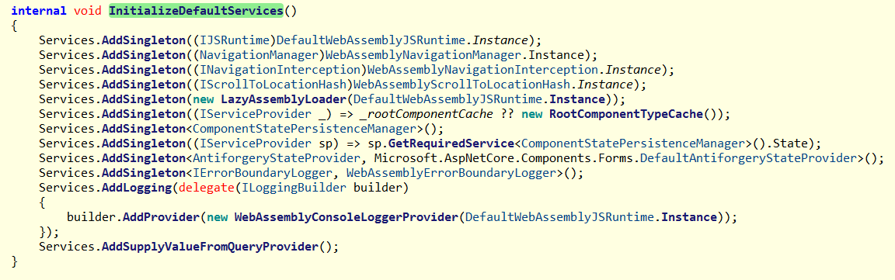
BlazorWeb Hosting

Slide 7
WebApplicationBuilder
Blazor.web hosting:
WebApplicationBuilder.Services.AddRazorComponents()

Slide 8
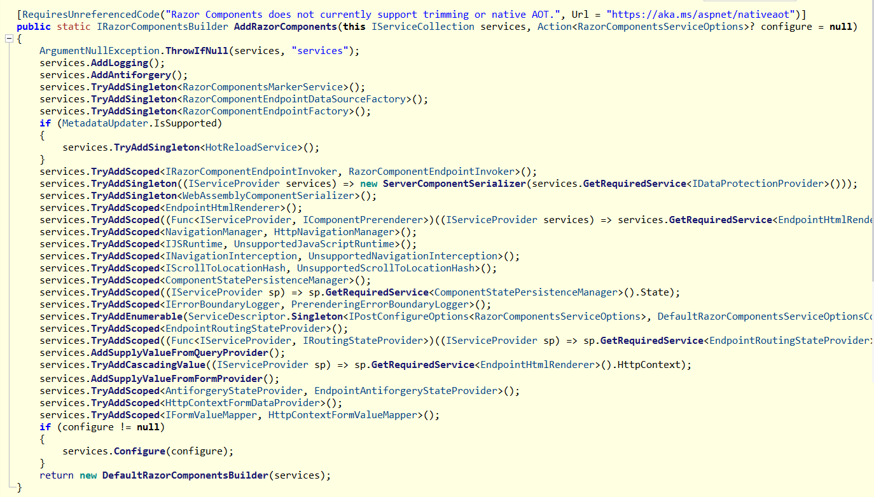

Slide 9
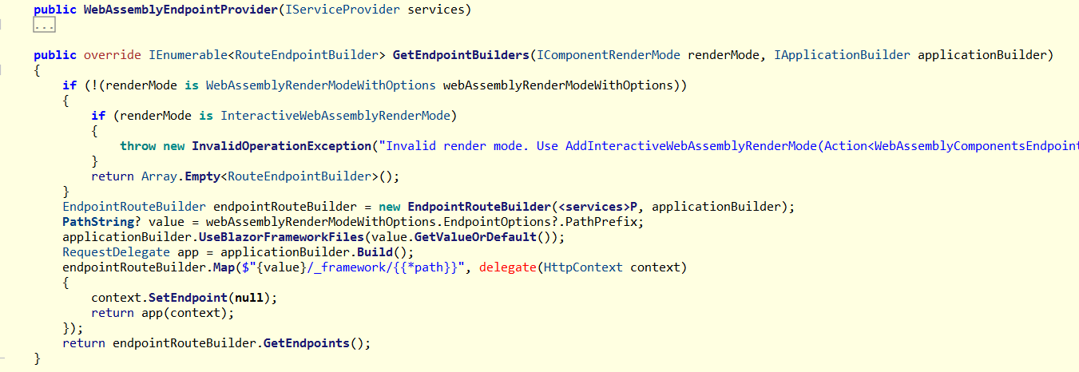
WebApplicationBuilder
AddInteractiveWebAssemblyComponents

Slide 10
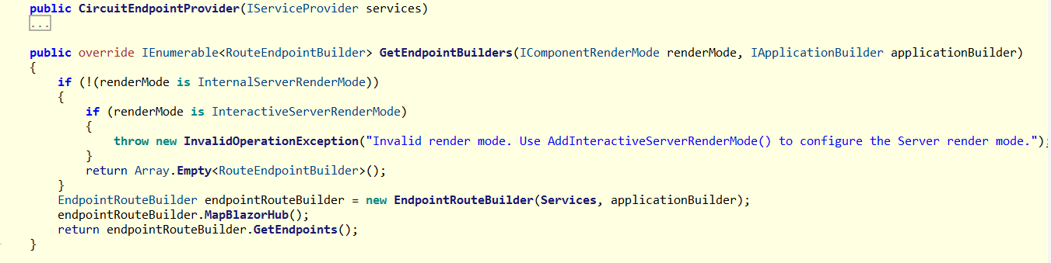
AddInteractiveServerComponents

Slide 11
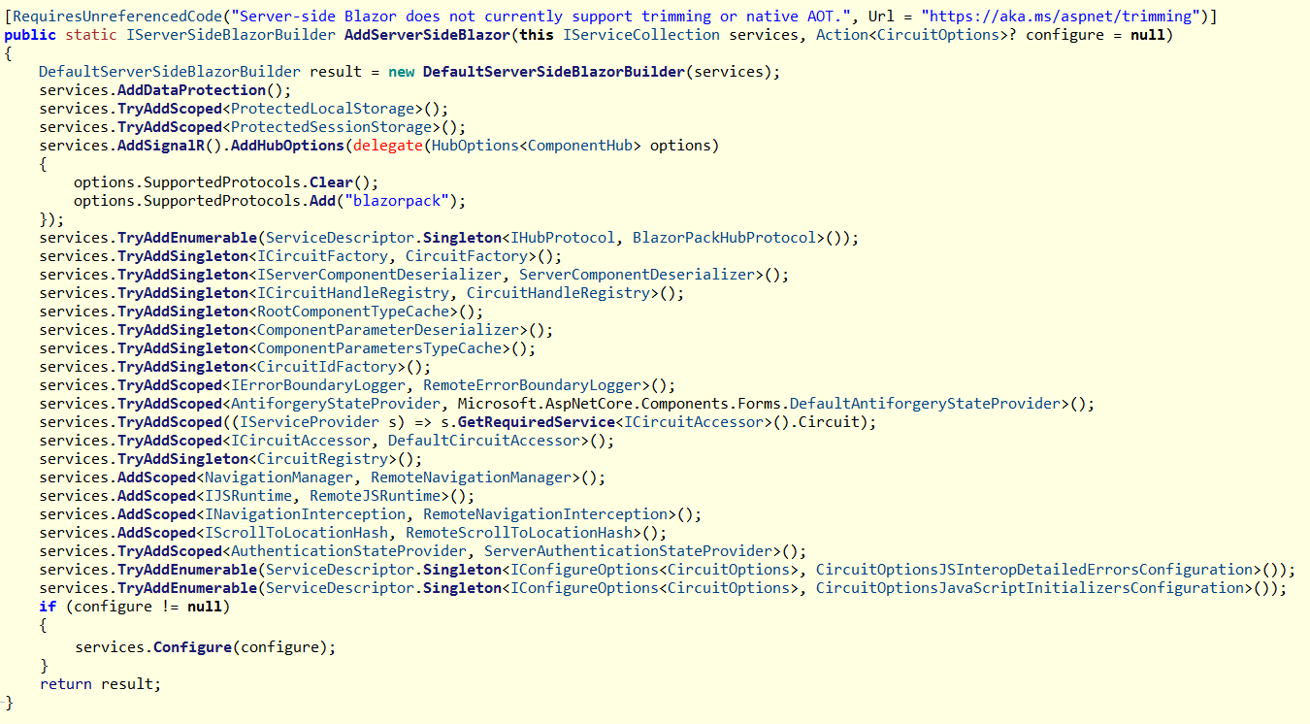

Slide 12
Life Cycle
ASP.NET Core Razor component lifecycle
Blazor Server/WebAssembly .net 6.0/8.0 | Blazor Web Server .net 8.0 | Blazor Web WebAssembly .net 8.0 | Blazor Web Static .net 8.0
SetParametersAsync - Begin OnInitialized OnInitializedAsync OnParametersSet OnParametersSetAsync SetParametersAsync - End OnAfterRender (First render: True) OnAfterRenderAsync (First render: True) | SetParametersAsync - Begin OnInitialized OnInitializedAsync OnParametersSet OnParametersSetAsync SetParametersAsync - End SetParametersAsync - Begin OnInitialized OnInitializedAsync OnParametersSet OnParametersSetAsync SetParametersAsync - End OnAfterRender (First render: True) OnAfterRenderAsync (First render: True) | SetParametersAsync - Begin OnInitialized OnInitializedAsync OnParametersSet OnParametersSetAsync OnAfterRender (First render: True) OnAfterRenderAsync (First render: True) SetParametersAsync - End | SetParametersAsync - Begin OnInitialized OnInitializedAsync OnParametersSet OnParametersSetAsync SetParametersAsync - End

Slide 13
Render By different Mode
ComponmentFactory.cs
ComponmentFactory.InstantiateComponent
Renderer.ResolveComponentForRenderMode -> override by EndpointHtmlRenderer/RemoteRenderer

